Slide 1
Social Media +
Public Land
Dan Filler

Slide 2
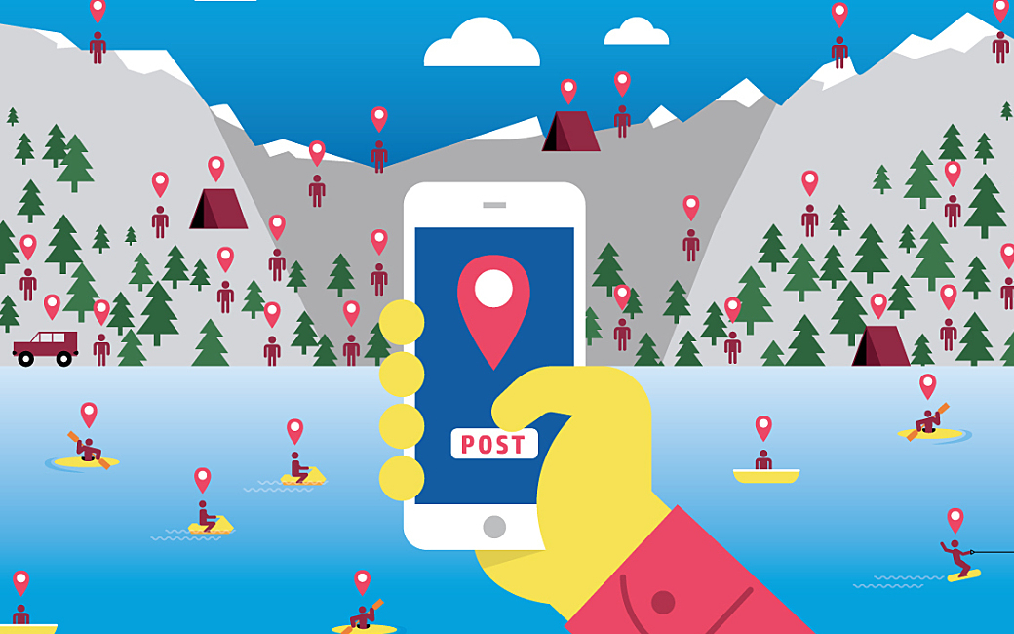
Background
Geotagging posts is a widespread feature among social media apps
Allows user to add a specific location to their post
Through geotagging, others who interact with the post can see where the photo was taken, spreading the word about an interesting location
Works very well for free publicity for businesses, vacation destinations, etc.
But...
Source: Gordon, 2017
<https://www8.hp.com/us/en/tektonika/index.php/2017/03/17/geotagging-when-really-cool-tech-is-actually-a-huge-bummer/>

Slide 3
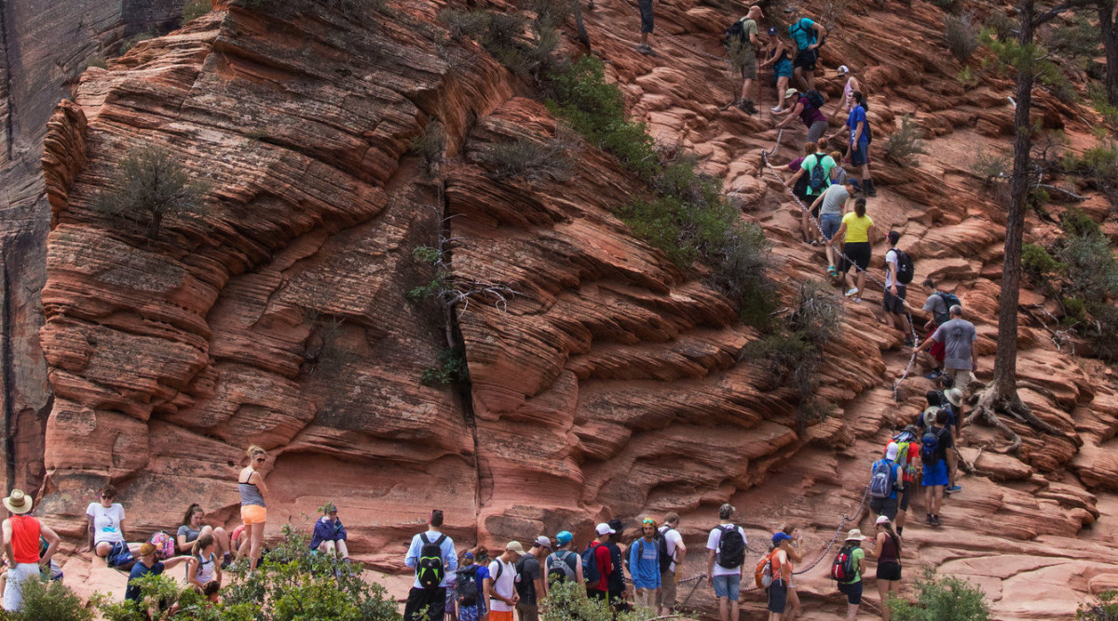
Background
National Parks are experiencing a swift increase in visitors
2016-2018 are the three highest years for attendance of all time
The department of the interior has funded several studies into correlation between social media and visitor rates
Online communities for outdoor recreation are growing
Source: Eller, 2017
<https://lnt.org/national-parks-overcrowding-in-the-news/>

Slide 4
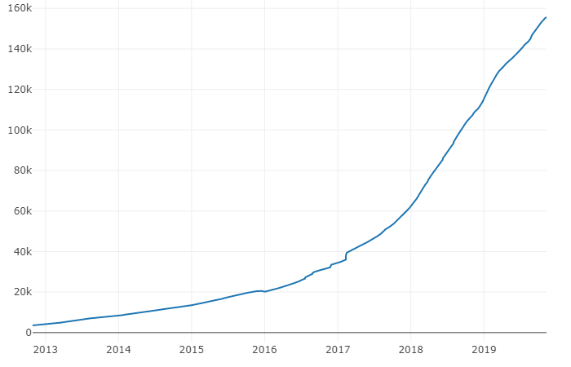
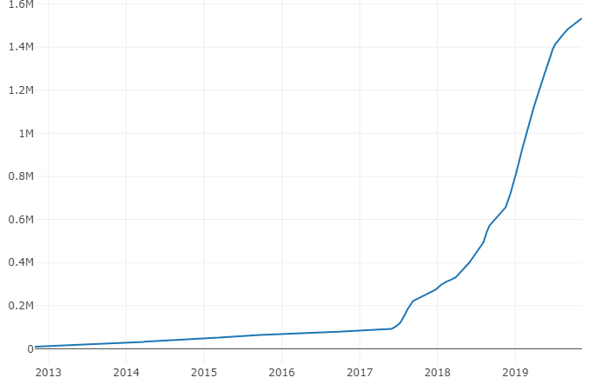
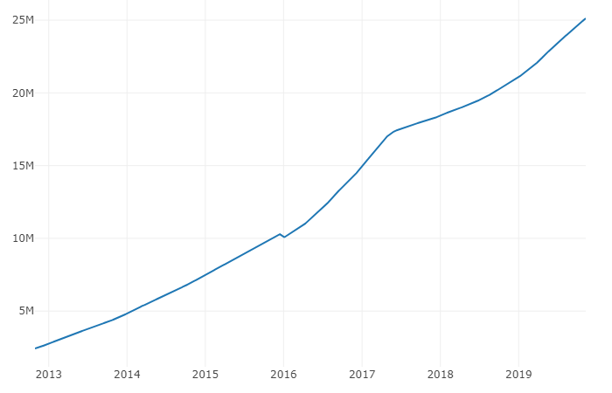
Background
/r/Ultralight
/r/Backpacking
/r/AskReddit
Source: SubredditStats, 2019
<https://subredditstats.com/>

Slide 5
The Ethical Question:
Is it permissible for software engineers to build Geotagging into social media sites with specific location information about conservational, publicly-owned land?

Slide 6
Competing Answer 1: Yes, it is permissible.
Geotagging supports the economy, parks funding, etc.
Disabling geotagging for certain obscure areas is elitist
gatekeeping
May even be that more visitation improves quality of parks
Inspires more conservation efforts, more funding, etc.
Popularizing lesser-known recreation areas allows the load to be distributed

Slide 7
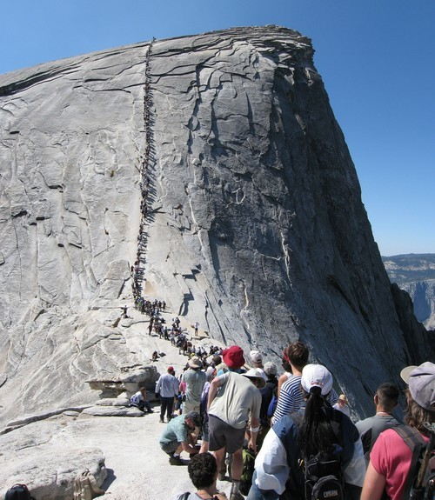
Competing Answer 2: No, it is not permissible.
Natural conservation areas are different than other places of interest
Far more susceptible to destruction, particularly from crowds
Some studies have found higher visitation is in fact worse for parks
(Grau and Freemund, 2007), (Wood et al. 2013), (Fan, 2019)
Higher risk presented by overcrowding than losing protected status
More public interest does not equal quality public involvement
E.g. Hiking Groups breaking rules
Source: Hughs, 2017
<https://e360.yale.edu/features/greenlock-a-visitor-crush-is-overwhelming-americas-national-parks>

Slide 8
My Answer
It is permissible for software engineers to build Geotagging into social media sites with specific location information about conservational, publicly-owned land.

Slide 9
Ethical Support
From Utilitarianism an act is morally required given it provides the greatest net balance of good
Limiting access to knowledge means fewer people get to experience naturally important places
Generally, visiting beautiful natural sites is very pleasurable
Disproportionately affects little-known areas - everyone already knows about Zion NP
Maps are already available through the internet for basically every wilderness area
In fact, it is entirely possible that this wave of new visitors will increase protections, funding, and conservation efforts
Therefore: Implementing geotagging is a net higher benefit and is morally permissible (and required)

Slide 10
Code of Ethics Support
Somewhat ambiguous in this case - but a few applicable guidelines:
Section 3.03 requires software engineers to identify issues relating to their work, including environmental issues
Section 1.03 requires that software not invade privacy or harm the environment
Section 3.14 requires that data should be held up to date and accurate, a task made possible through collecting geotagged information
Section 3.01 requires that engineers strive for high-quality products, which considers the desires of the user

Slide 11
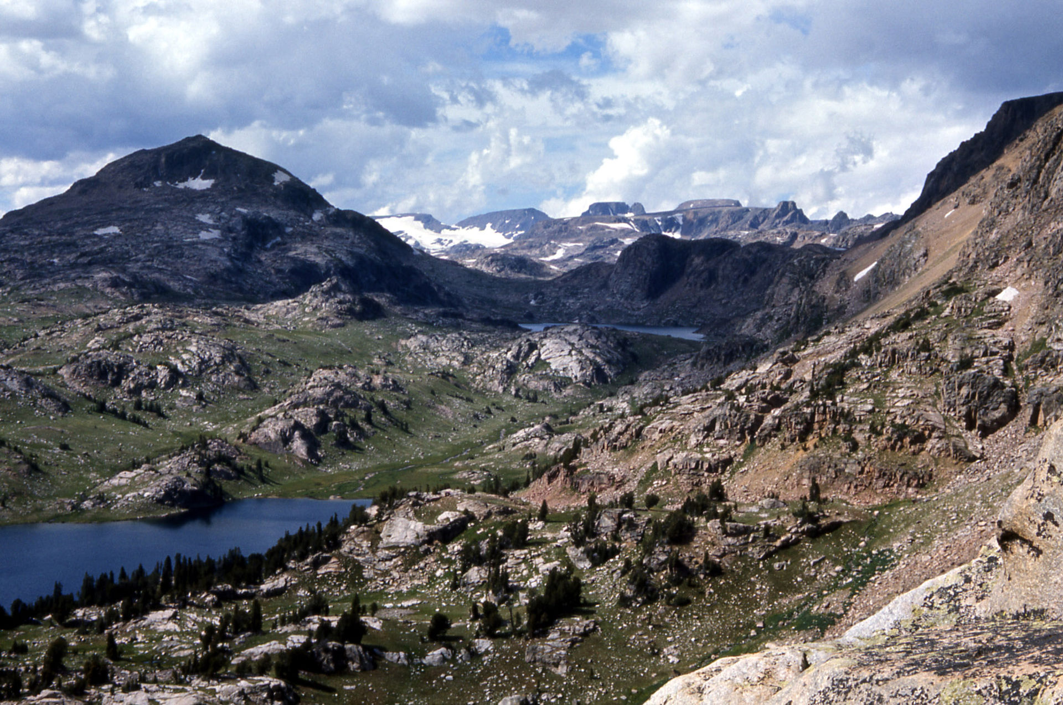
Implications
The best case scenario is that an increasingly interested population correlates to increased funding and conservation efforts
Works if the public is both educated about LNT, conservation, etc. and engaged
More lesser-known public recreation areas get the attention and funding they deserve
Source: National Forest Service

Slide 12
Conclusion
Social Media use has a positive correlation with the number of visitors to our protected land
Geotagging may be a significant factor in this correlation
While Geotagging may have adverse effects such as overcrowding, banning it from use with public land is elitist and unfair
Increased visitation may improve funding and conservation, ultimately improving the quality of our parks

Slide 13
Bibliography
Annual Visitation Highlights. (2018). Retrieved from https://www.nps.gov/subjects/socialscience/annual-visitation-highlights.htm.
Fan, H.-J. (2019). Sustainability & Tourist-Crowding Trade-Off at Wildlife Based Tourist Spots: A Study on Ecotourism Carrying Capacity of Lanyang Hot Spring National Forest Park in Danzhou City, Hainan Province. DEStech Transactions on Engineering and Technology Research, (amsms). doi: 10.12783/dtetr/amsms2019/31847
Gotterbarn, D., Miller, K., & Rogerson, S. (1997, November). Software engineering code of ethics. Commun. ACM, 40(11), 110–118. doi: 10.1145/265684.265699
Grau, Kara and Freimund, Wayne PhD. (2016). "THE EFFECT OF SOUND AND CROWDING ON TOURIST EXPERIENCES IN A NATIONAL PARK SETTING". Travel and Tourism Research Association: Advancing Tourism Research Globally. 49. https://scholarworks.umass.edu/ttra/2007/Presented_Papers/49
Shafer-Landau, R. (2018). The fundamentals of ethics. New York Oxford: Oxford University Press.

Slide 14
Questions?

